Slide 1

Reception Intake September 2022

Slide 2
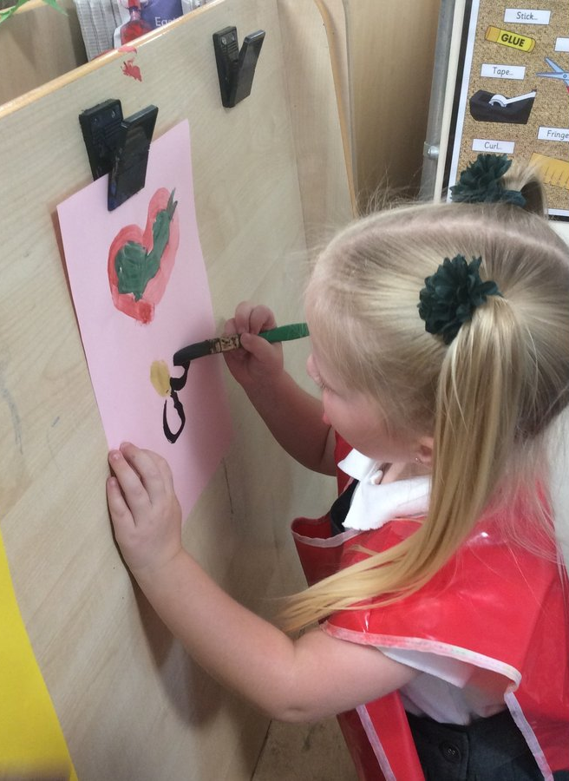
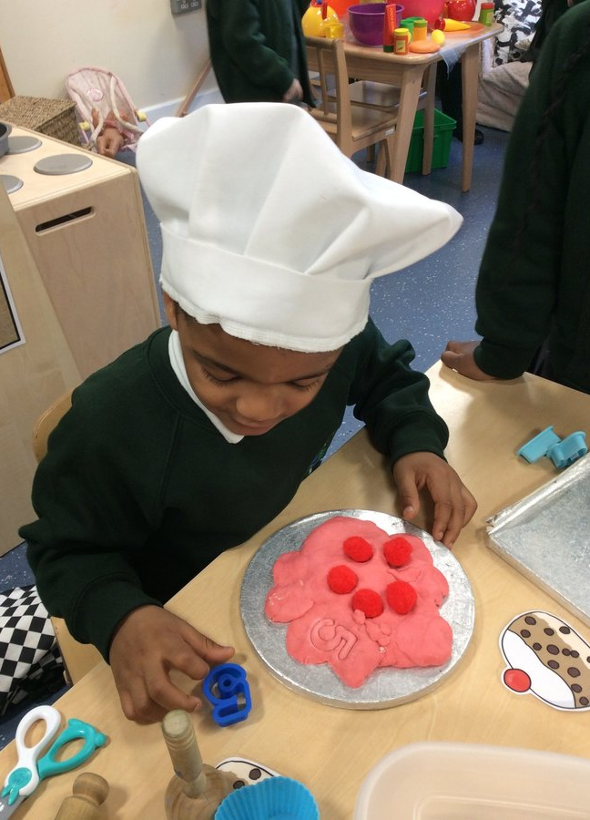
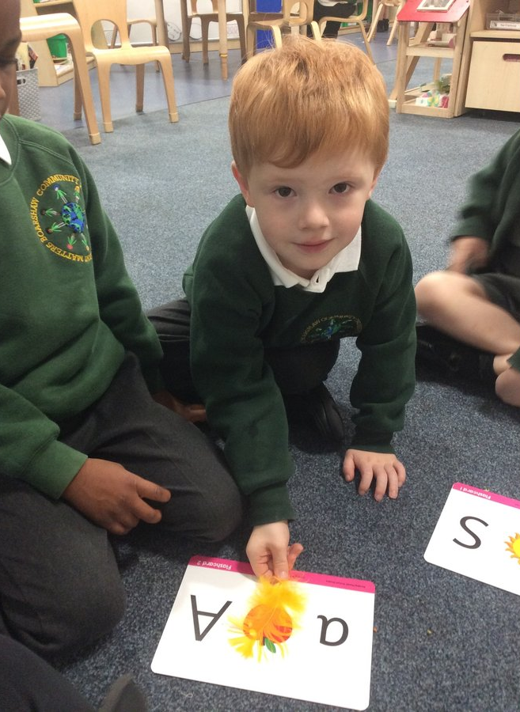
Welcome to our school
Firstly let me welcome you to Boarshaw Primary School. We are looking forward to meeting you and your child.
Notes:
NOTE: To change images on this slide, select a picture and delete it. Then click the Insert Picture icon in the placeholder to insert your own image.

Slide 3
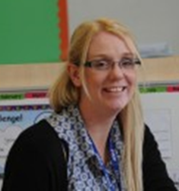
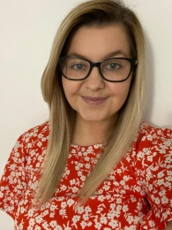


Meet the staff
We have two Reception classes called Clownfish and Blue tang. There are two classroom bases but children will be able to access the provision in both classrooms.
Mrs Crowther
Reception Clownfish Class Teacher and Foundation Stage Leader
Miss Ball
Reception Blue tang Class Teacher
Notes:
NOTE: To change images on this slide, select a picture and delete it. Then click the Insert Picture icon in the placeholder to insert your own image.

Slide 4
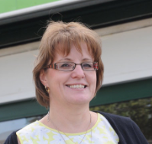
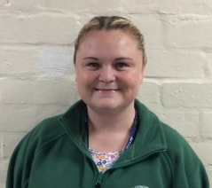
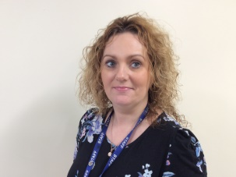
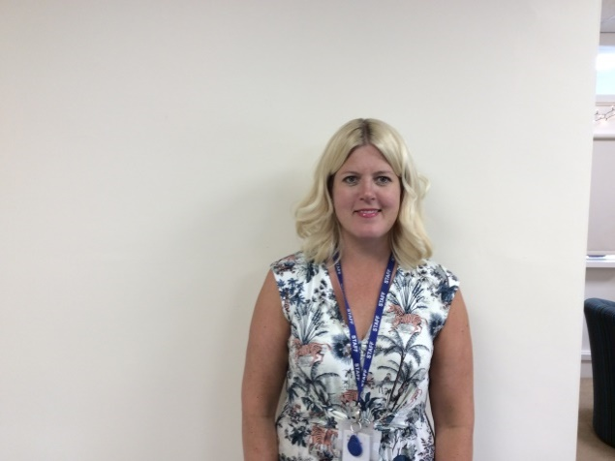
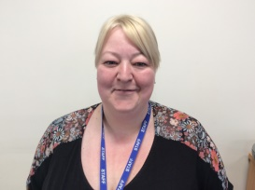
Other staff
Mrs Evans
(Early Help)
Ms Harland
(Headteacher)
Mrs Parr
(School Business Manager)
Mrs Facchin (Deputy Headteacher/SENCO)
Mrs Meehan
(Senior administrator)
Notes:
NOTE: To change images on this slide, select a picture and delete it. Then click the Insert Picture icon in the placeholder to insert your own image.

Slide 5
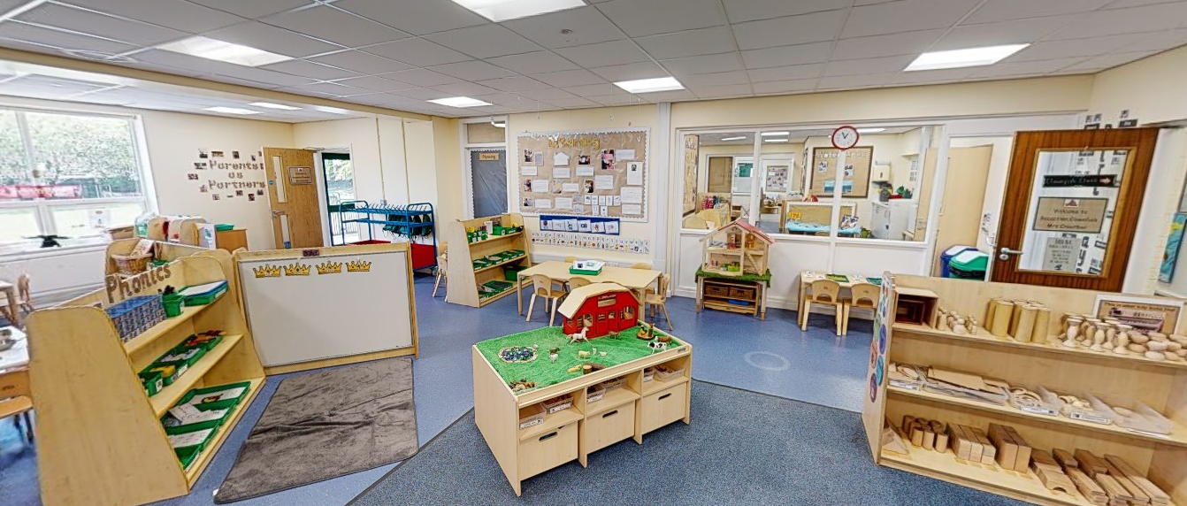
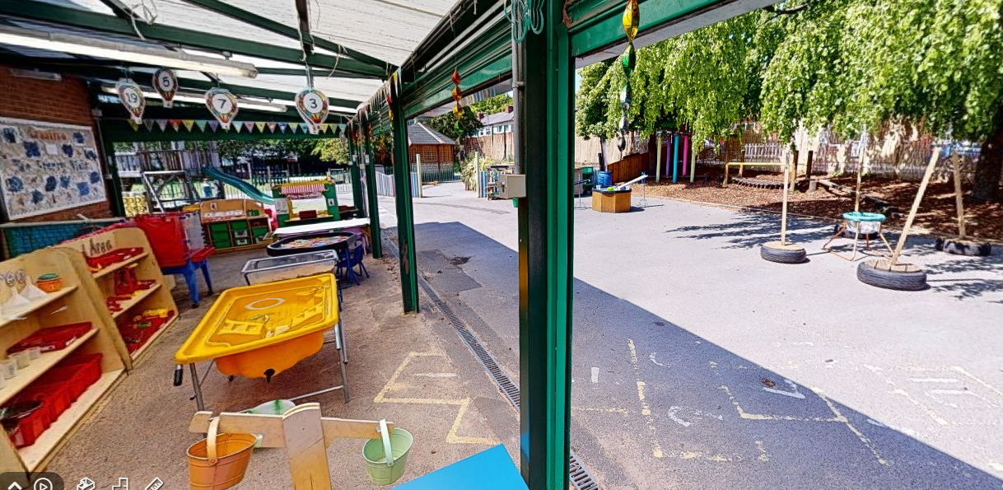
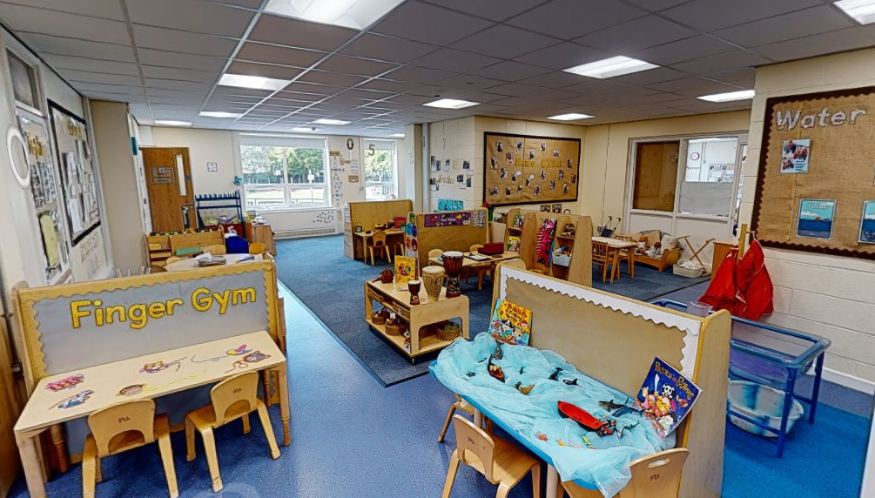
Foundation Stage Unit
Clownfish
Outdoors
Blue tang
Children will access both classrooms and share the outdoor area with Nursery.
Notes:
NOTE: To change images on this slide, select a picture and delete it. Then click the Insert Picture icon in the placeholder to insert your own image.

Slide 6

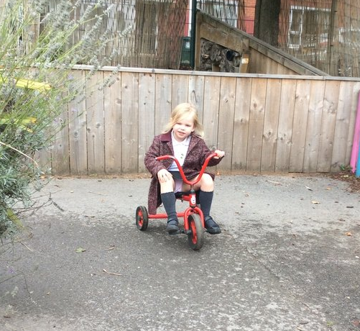
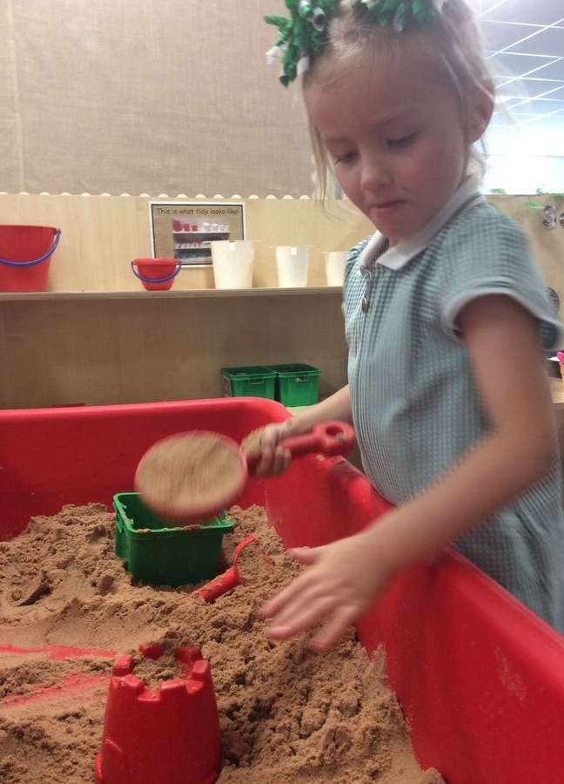
What is the EYFS?
EYFS is the Early Years Foundation Stage education for 5s and under
There are 7 areas of learning- 3 prime areas and 4 specific areas, which we teach through areas of provision and directed activities.
Children access the learning in both Reception classrooms and the outdoor area

Slide 7
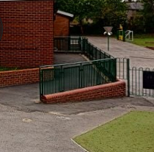
General Information
School day 8:45-3:15
Breakfast club 8:00-8.45, £1 each. You must inform the office if your child is attending.
Home time 3.15pm please arrive on time to collect your child as children can become upset if there is no one to collect them on time. Reception are dropped off and collected from the ramp.
If for any reason you are going to be late collecting your child please telephone the school office.
Children can only be collected by an adult on the collection list please inform staff/office if the person collecting your child is changing

Slide 8

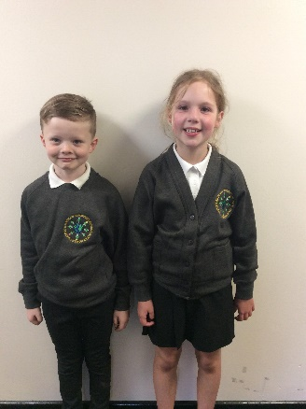
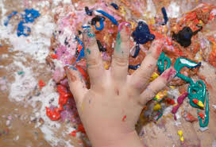
What I need to start school
School Uniform
Black- trousers/skirts
White polo shirt
Grey jumper or cardigan
Black school shoes (Velcro fastening)
Bookbag (provided by school)
Summer dress/shorts may be worn in the summer.
Warm, waterproof coat
Wellington boots
Please label everything!
Uniform will be available to purchase at Icon on Middleton Arndale
EYFS is messy!
Please do not send children in expensive coats. They will get dirty!
Notes:
NOTE: To change images on this slide, select a picture and delete it. Then click the Insert Picture icon in the placeholder to insert your own image.

Slide 9
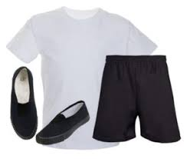

What I need to start school
PE Kit
White T-shirt
Black shorts
Pumps/trainers
Jogging pants
Jumper
Please send in a labelled PE kit in a drawstring bag. PE kits will be sent home at the end of every half term.
Notes:
NOTE: To change images on this slide, select a picture and delete it. Then click the Insert Picture icon in the placeholder to insert your own image.

Slide 10

What I need to start school
Outdoor Clothes
Wellington Boots
Spare socks (lots!)
Change of clothes
Hat
Gloves
Cap/Summer hat (Summer only)
Children in Reception will have access to outdoors throughout the year, in any weather. Please ensure children have a suitable outdoor coat. We ask that wellington boots are left in school all year.
Please also ensure a full change of clothes, including multiple socks are in your child’s book bag.
Notes:
NOTE: To change images on this slide, select a picture and delete it. Then click the Insert Picture icon in the placeholder to insert your own image.

Slide 11

Lunchtime
Children will eat lunch in the canteen and all Reception children are entitled to a free school meal. We would like all children to have school dinners as this provides an opportunity for children to socialise with their new friends, enjoy trying new foods and helps with independence.
Our kitchen offers a range of hot meals on a two week cycle (see website for further details).
Daily options include jacket potatoes, panini and sandwiches.
We encourage children to have a hot meal everyday. We allow one sandwich a week unless otherwise advised by parents.
Please ensure we are informed of any allergies or dietary needs.
We advise all children to start on a school meal but if your child brings a packed lunch please follow the schools healthy lunch guidance.

Slide 12
Wrap around care
Breakfast club 8:00-8.45am, £1 a day. You must book in advance as there are limited places available.
After school club 3.15-5.30pm, £4 a day and must also be booked in advance.

Slide 13





Parent Partnership
  Home and school are the two most powerful influences on your child and they should always be working together.
It is vital that parents and teachers work together to ensure children receive the best education. At Boarshaw Primary we have various ways to keep you informed.
Class Dojo
This is an APP you download on your phone or access via laptop/tablet . You will be sent a unique code to link you to your child. You will be able to send messages to the class teacher on her. Teachers will also send your messages and pictures of what the class has been doing.
Tapesty
This is an APP you download on your phone or access via laptop/tablet and. It allows you to see what your child has been learning. Teachers will upload observations of children showing new learning. Parents can also upload pictures and information to tell the teacher what they have been doing at home.
https://www.boarshawprimary.co.uk/

Slide 14


Toilet
Please let us know if your child is not fully toilet trained, we are here to help.
In the first few week lots of children have accidents. Please send in a spare set of clothes (skirt/ trousers, underwear and socks) in your child’s book bag. Please ensure all items are labelled.

Slide 15

Home visits
Home visits give us the opportunity to get to know each other in a place where you feel most at ease.
Please sign up for an appointment time tonight.
Children who currently attend our nursery do not routinely have a home visit but if would like to meet please speak to a member of staff.

Slide 16
Stay and Play
We are holding two stay and play sessions one with parents and one without. These sessions enable your child to get to know the staff and the classroom environments.
Details can be found in your pack.
Please inform us if you can not attend.
Some children might need additional settling in sessions and these will be discussed with parents when necessary.

Slide 17
Things to remember
Complete all forms to receive a free book bag
Start time 8.45am and finish time 3.15pm
Please inform us of any change in collection.
Book bags must come to school everyday. This is the only bag to be brought to school.
PE kit to be brought to school in the first week.
Bring a pair of wellington boots
Send in spare socks and spare clothes.

Slide 18
Tonight
Fill in the data collection/FSM/GDPR sheets.
Complete the Tapestry and Dojo forms.
Meet the staff and look around the unit.
Choose a date for your home visit and confirm your address.
Feel free to ask questions!
Thank
you!

