Slide 1

Reception Intake September 2020

Slide 2
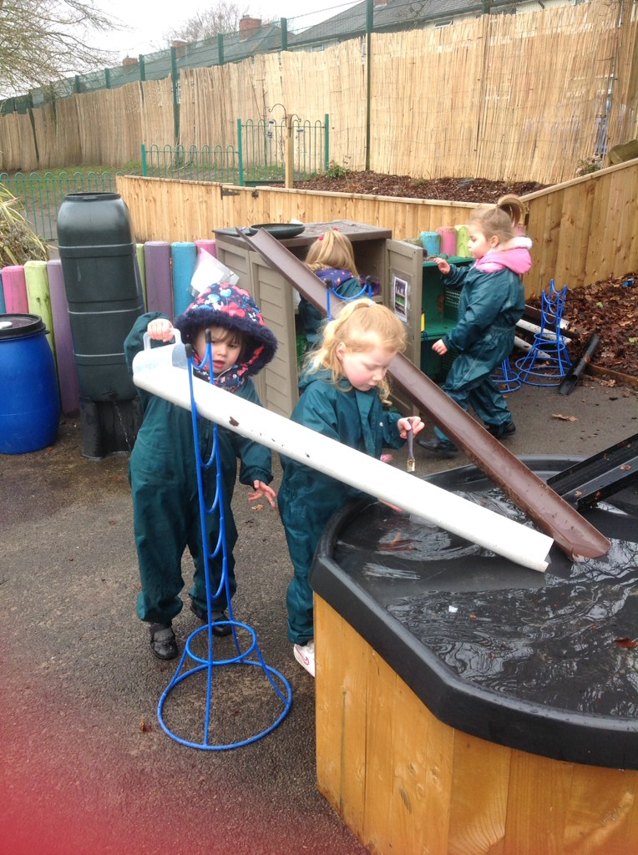
Welcome to our school
Firstly let me welcome you to Boarshaw Primary School. We are looking forward to meeting you and your child. Although some aspects of starting school have changed we will ensure that your child will be given the best possible start to their education.
Notes:
NOTE: To change images on this slide, select a picture and delete it. Then click the Insert Picture icon in the placeholder to insert your own image.

Slide 3
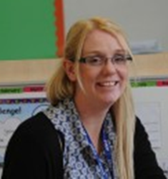
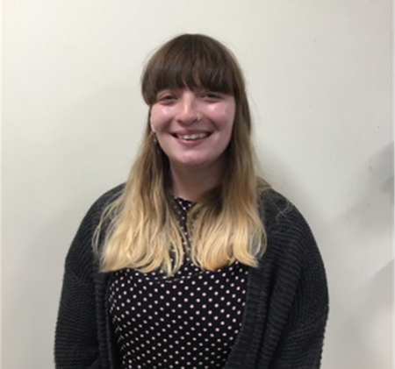


Meet the staff
We have two Reception Classes called Clownfish and Bluetang. There are two classroom bases but children will be able to access the provision in both classrooms.
Mrs Crowther
Reception Clownfish Class Teacher and Foundation Stage Leader
Miss Plant
Reception Bluetang Class Teacher
Notes:
NOTE: To change images on this slide, select a picture and delete it. Then click the Insert Picture icon in the placeholder to insert your own image.

Slide 4
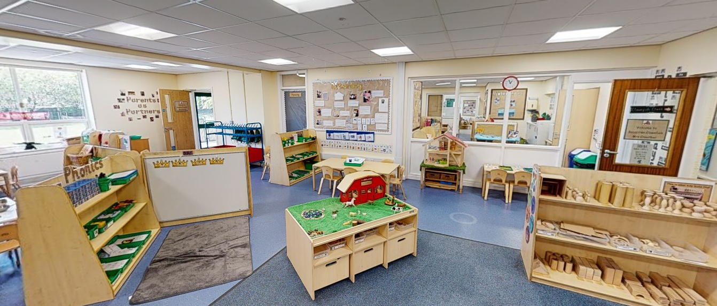
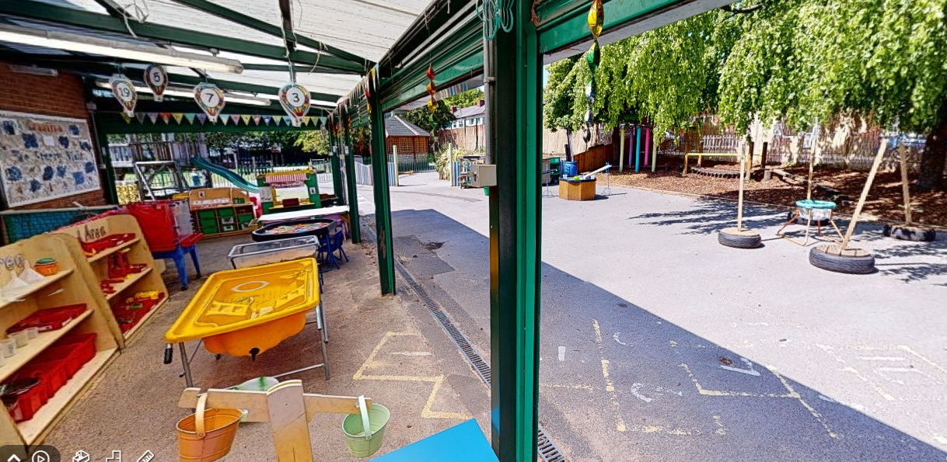
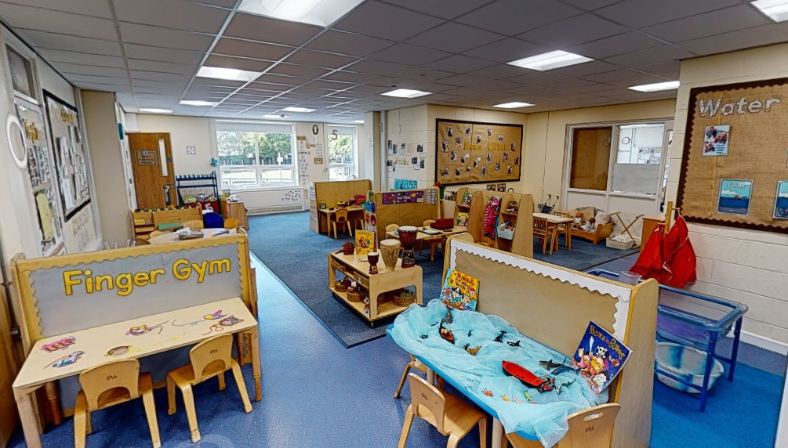
Foundation Stage Unit
Clownfish
Outdoors
Bluetang
Children will access both classrooms and share the outdoor area with Nursery.
The Foundation Stage Unit forms one ‘Bubble’
Notes:
NOTE: To change images on this slide, select a picture and delete it. Then click the Insert Picture icon in the placeholder to insert your own image.

Slide 5

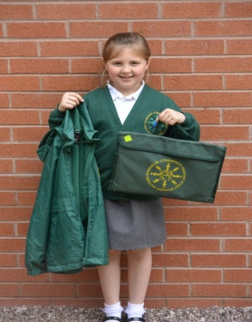
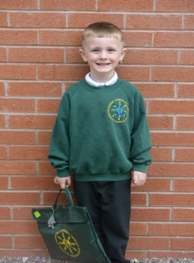
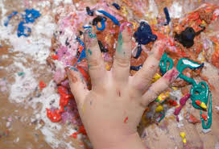
What I need to start school
School Uniform
Grey- trousers, skirt or shorts
White polo shirt
Green jumper or cardigan
Black school shoes (Velcro fastening)
Bookbag (provided by school)
Summer Dress may also be worn in the summer.
Warm, waterproof coat
Wellington boots
Please label everything!
EYFS is messy!
Please do not send children in expensive coats. They will get dirty!
Notes:
NOTE: To change images on this slide, select a picture and delete it. Then click the Insert Picture icon in the placeholder to insert your own image.

Slide 6
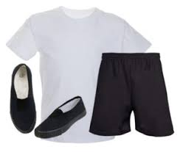

What I need to start school
PE lessons Thursday and Friday
PE Kit
White T-shirt
Black shorts
A jumper
Pumps
Black trainers
In the winter please send jogging pants
In line with current guidance PE lessons will be taking part outdoors where possible so please include suitable clothing.
Please send in a labelled PE kit in a drawstring bag. PE kits will be sent home at the end of every half term.
Notes:
NOTE: To change images on this slide, select a picture and delete it. Then click the Insert Picture icon in the placeholder to insert your own image.

Slide 7

What I need to start school
Outdoor Clothes
Wellington Boots
Spare socks (lots!)
Change of clothes
Hat
Gloves
Cap/Summer hat (Summer only)
Children in Reception will have access to outdoors throughout the year, in any weather. Please ensure children have suitable outdoor coats. We ask that wellington boots are left in school all year.
Please also ensure a full change of clothes, including multiple socks is in school.
Notes:
NOTE: To change images on this slide, select a picture and delete it. Then click the Insert Picture icon in the placeholder to insert your own image.

Slide 8
Before starting school
Please ensure all data forms are completed and handed into the school office.
Ensure your collection form is up to date- only people named on this will be able to collect.
Talk to your child about some of the changes within school such as washing our hands regularly and not putting toys in our mouth.

Slide 9

Before starting school
Stay and Play
Children should have received an invite to stay and play on Friday 4th September your time slot will be on your invite. Please ring the school office if you are unsure about the time.
On this day please bring children to the school office where they will be met by a member of staff.
Please arrive promptly to collect the children to enable us to clean and prepare the classroom for the next group.

Slide 10

Starting School
To support children’s transition into school we will be staggering our intake over three days from Monday 7th September to Wednesday 9th September. You will have received information about your child’s start date in your welcome pack. If you are unsure please contact the school office.

Slide 11
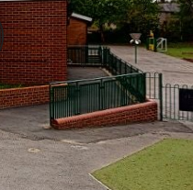
Starting School
Please ensure that children do not bring any toys to school. Children should only bring their school bookbag. No other bags or items will be allowed in school.
Please wash children’s hands before they come to school.
If your child is wearing a face covering to travel to school please remove at school.
Children should be brought to the Reception Ramp this is best accessed from the Tennyson Road entrance.
Please arrive at the specified time. Surnames A-L 8.45am, M-Z 9am. Children must arrive on time, there is no longer a staggered intake between 8.45 and 9am.
To allow for safe social distancing between parents we ask that children are left with the teacher on the ramp they will then be supported in school by members of staff. Unfortunately at this time we are unable to allow parents into the school building.
Reception Ramp

Slide 12
In school
Once in school children will sanitise their hands, put their coat on a peg and bookbag in a box.
Children will then take part in a range of activities throughout the school day, some adult led carpet times, adult directed activities and some child initiated learning time.
Snack and milk will be provided each day (please ensure we are informed of your child’s allergies)

Slide 13

Lunchtime
Children will eat lunch in the canteen and all Reception children are entitled to a free school meal.
Our kitchen offers a range of hot meals on a two week cycle (see website for further details).
Daily options include jacket potatoes, panini and sandwiches.
We encourage children to have a hot meal everyday. We allow one sandwich a week unless otherwise advised by parents.
Please ensure we are informed of any allergies or dietary needs.
We advise all children to start on a school meal but if your child brings a packed lunch we ask that it is a plastic lunchbox that is easily cleaned.

Slide 14
End of school
Please collect from the bottom of the Reception Ramp we ask parents to ensure they socially distance.
Please collect at your specific time (surnames A-L 3pm and M-Z 3.15pm)
Any communication between parents and teacher will take place over the telephone or via email.
Please ensure you arrive on time children become upset if there is no one to collect them.
Please keep your collection form up to date as children will only be able to leave with the person on the list.

Slide 15
Wrap around care
Breakfast club 8:00-8.45am, £1 a day. You must book in advance as there are limited places available. Children will be in a Breakfast Club Bubble with Reception and Nursery children.
After school club 3.15-5.30pm is £4 a day and must also be booked in advance. Children will be in an after school club bubble with Reception and Nursery children.

Slide 16


Toilet
Please let us know if your child is not fully toilet trained, we are here to help.
In the first few week lots of children have accidents. Please send in a spare set of clothes (skirt/ trousers, underwear and socks) in a labelled bag. Please ensure all items inside are labelled.

Slide 17





Parent Partnership
  Home and school are the two most powerful influences on your child and they should always be working together.
It is vital that parents and teachers work together to ensure children receive the best education. At Boarshaw Primary we have various ways to keep you informed.
Class Dojo
This is an APP you download on your phone or access via laptop/tablet . You will be sent a unique code to link you to your child. You will be able to send messages to the class teacher on her. Teachers will also send your messages and pictures of what the class has been doing.
Tapesty
This is an APP you download on your phone or access via laptop/tablet and. It allows you to see what your child has been learning. Teachers will upload observations of children showing new learning. Parents can also upload pictures and information to tell the teacher what they have been doing at home.
https://www.boarshawprimary.co.uk/

Slide 18
Things to remember
To return the data collect forms
Start and finish times A-L 8-45-3pm, M-Z 9-3.15pm
Please inform us of a change in collection.
Book bags must come to school everyday. This is the only item to be brought to school.
PE kit to be brought to school in the first week. .
Bring a pair of wellington boots
Send in spare socks and spare clothes.
Feel free to ask questions!
Thank you!

